Slide 1

Data Visualization Quiz | Toronto Covid-19 Dataset
Kalpana Prasad
Sylvester William Lall
Thursday, Aug 7, 2020

Slide 2


Agenda
Objectives
Data Preview
Introduction
Conclusion
Data Visualization & Insights

Slide 3
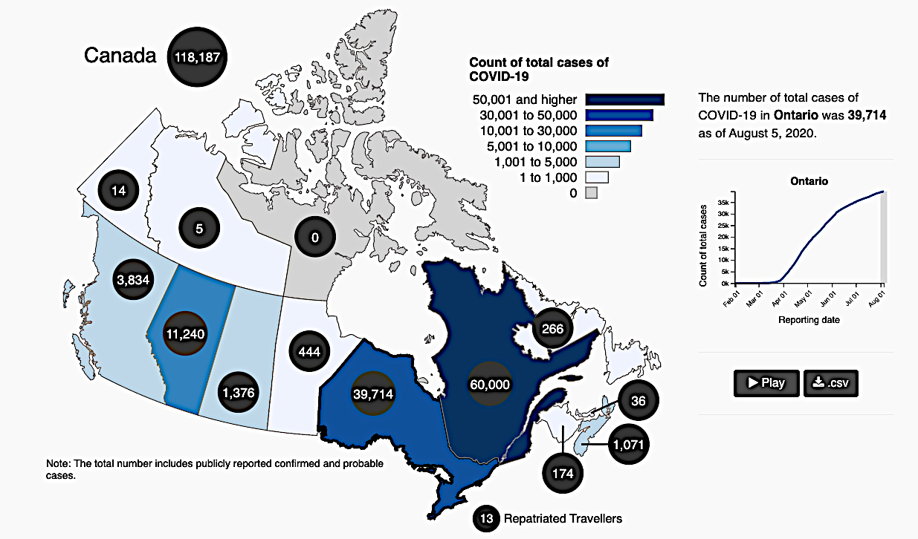
INTRODUCTION
Coronavirus Disease Pandemic (COVID-19)
The Virus : Severe Acute Respiratory Syndrome Coronavirus 2(SARS‑CoV‑2)
Discovery : December 2019
Place of Origin : Wuhan’s Huanan seafood market, China
Covid-19 cases as on Aug 1st, 2020
Globally – 18,519,579
Canada – 118,187
Ontario – 39,714
Toronto – 15,432
OBJECTIVES
To graphically represent the data
To rendering the data more intuitive
To draw insights from visual representation as opposed to numerical data

Slide 4
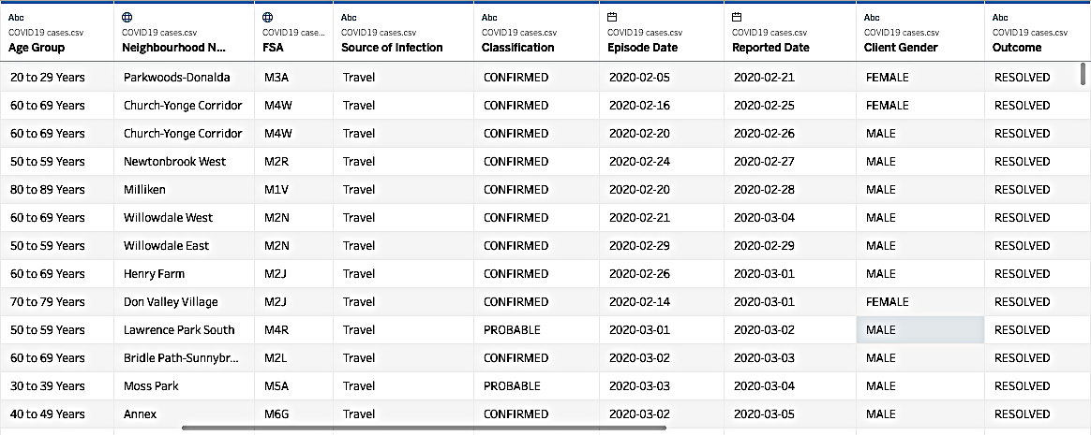


DATA PREVIEW
COVID-19 cases in Toronto
Id
Classification
Age Group
Source of Infection
Neighborhood
Reported Date
Gender
Outcome
Source :Open Data Dataset. (n.d.). Retrieved August 06, 2020, from https://open.toronto.ca/dataset/covid-19-cases-in-toronto/
Tools Used

Slide 5

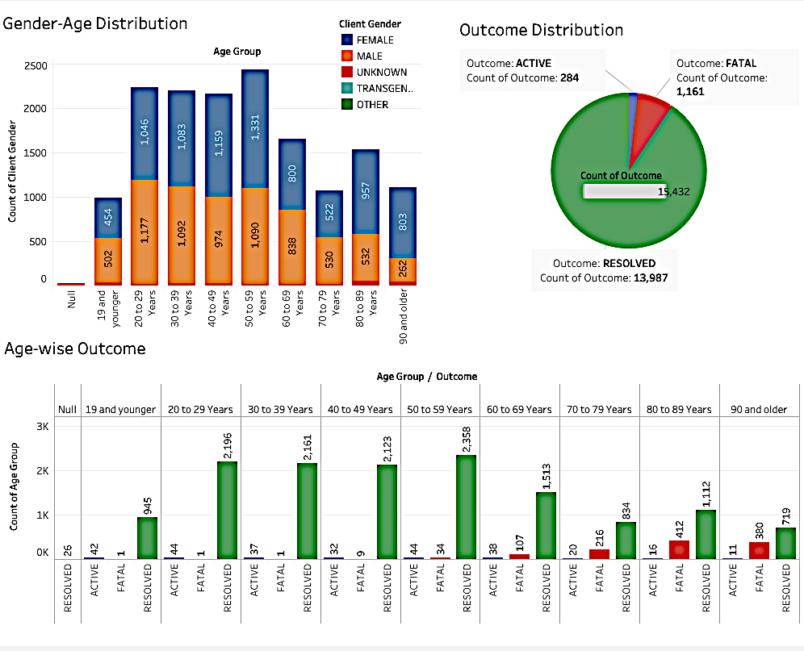
DATA VISUALIZATION
COVID-19 cases in Toronto
Key Insights
Total Dataset – 15,432
Females are the most vulnerable of all genders
Positive signs of recovery with ‘Resolved’ being the major contributor
Fatality is the highest amongst senior citizens
Younger age groups are equally vulnerable to contract the disease

Slide 6
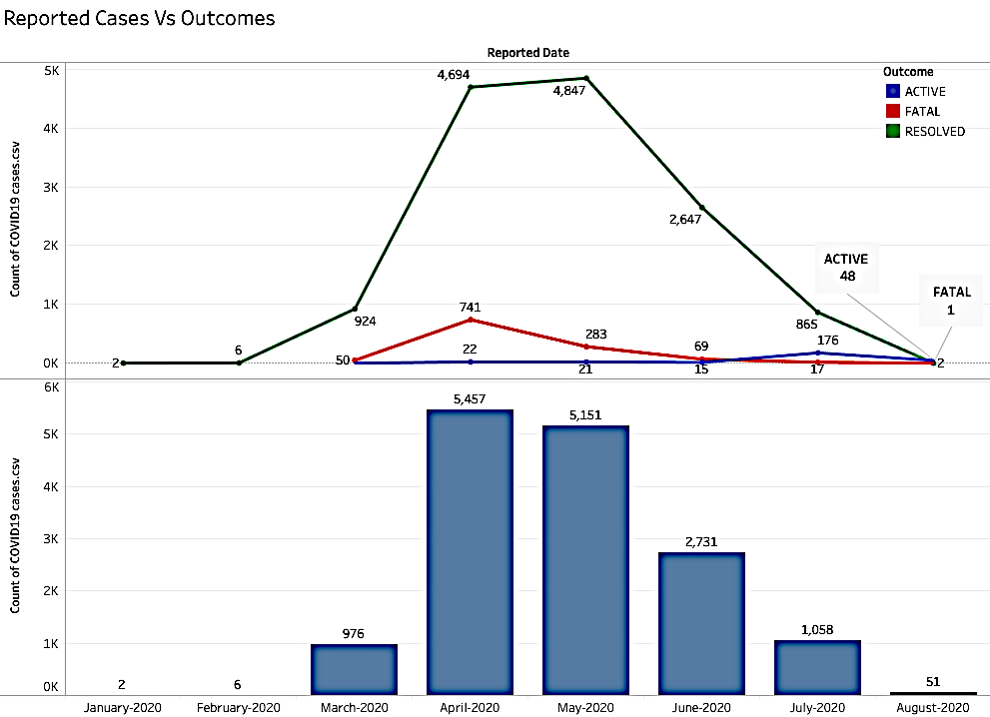
DATA VISUALIZATION
COVID-19 cases in Toronto
Key Insights
Worst effected month – April
Spike in nos. from March to April
No. of reported cases dip after May
Fatal count decrease steadily after April
5457 - highest reported cases

Slide 7
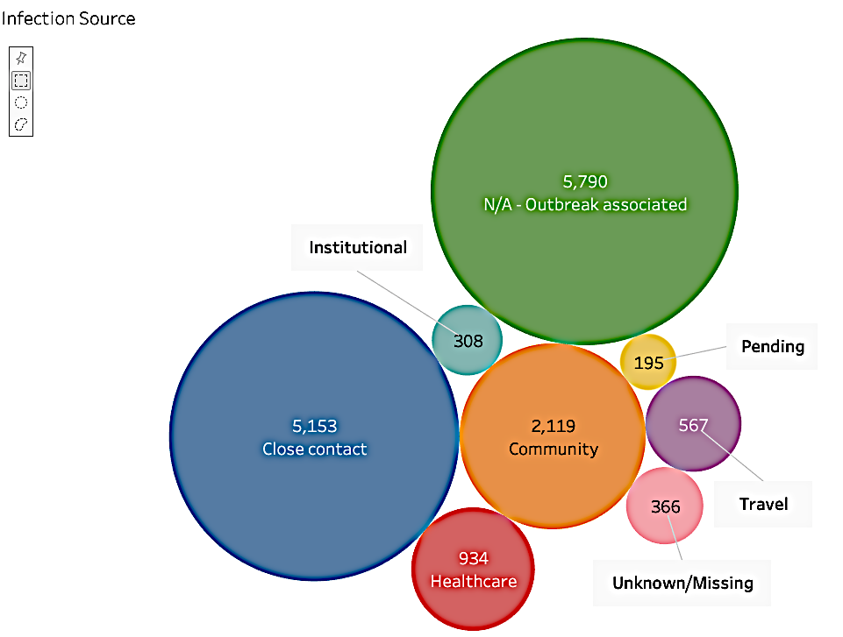
DATA VISUALIZATION
COVID-19 cases in Toronto
Key Insights
Major contributors – Outbreak & Close contact
Contraction due to travel is well contained at 567
366 cases are unidentified or missing
Social Distancing is the key

Slide 8

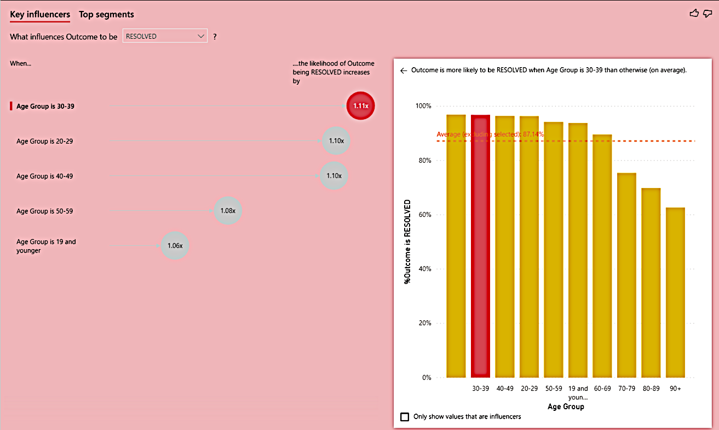
DATA VISUALIZATION
COVID-19 cases in Toronto
Key Insights
The likelihood of Outcome being RESOLVED increase by 1.1% with Age grp ‘30-39’
The likelihood of Outcome being FATAL increases by 6.02% with age grp of ‘90 and above’
The likelihood of Outcome being ACTIVE increases by 1.59% with age grp ‘19 and younger’

Slide 9
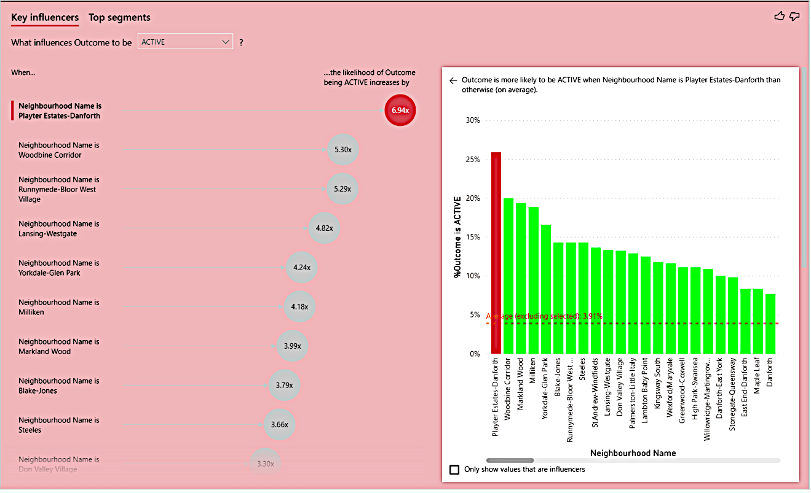
DATA VISUALIZATION
COVID-19 cases in Toronto
Key Insights
The likelihood of Outcome being Active increases by 6.9%in PLAYER ESTATES-DANFORTH
The likelihood of Outcome being RESOLVED increases by 1.13% in SOUTH MALVERN WEST
The likelihood of Outcome being FATAL increases by 4.6% in KENSINGTON-CHINATOWN

Slide 10
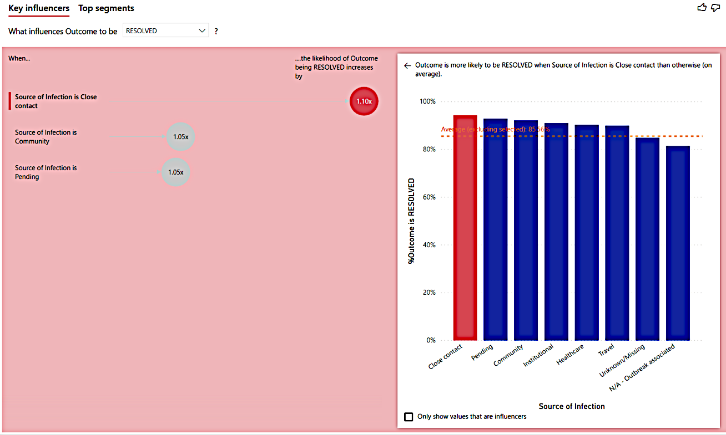
DATA VISUALIZATION
COVID-19 cases in Toronto
Key Insights
The likelihood of Outcome being ACTIVE increases by 3.34%
This is when the Source of the outcome is Unknown
The likelihood of Outcome being Fatal increases by 5.9%
The likelihood of Outcome being RESOLVED increases by 1.100%

Slide 11
Thank You

